Slide 1
Time and Space in Python
Data Analytics

Slide 2


















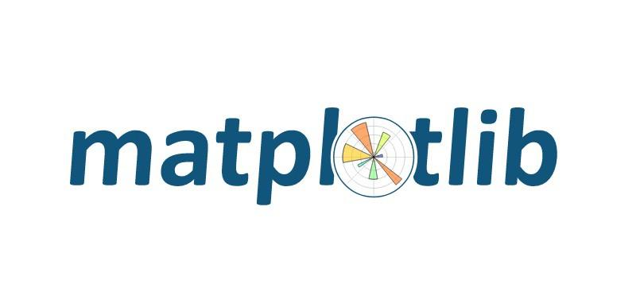







Anaconda
Jupyter
Data Types
Classes
loops
Containers
Machine Learning
You are here!
Data Science

Slide 3
Agenda
Introduction/Recap – 10 min
Dates in Python - 50 min
APIs in Python - 60 min
Maps in Python – 60 min
Vadim sings ‘Nessun Dorma’ Lunch - 60 min
Machine learning in Python - 3 hrs

Slide 4
Dates and Times in Python

Slide 5
datetime.datetime
import datetime as dt
now=dt.datetime.now()
x = dt.datetime(2020, 5, 17)

Slide 6
datetime.date
import datetime as dt
today = dt.date.today()
timestamp = dt.date.fromtimestamp(1326244364)

Slide 7
Create a Date
a = dt.datetime(2017, 11, 28, 23, 55, 59, 342380)
print("year =", a.year)
print("month =", a.month)
print("hour =", a.hour)
print("minute =", a.minute)
print("timestamp =", a.timestamp())

Slide 8
Date Differences
print (dt.date.today()-dt.date(year = 2017, month = 12, day = 23))
now=dt.datetime.now()
yesterday = now.day -1
yesterday_datetime= dt.datetime(now.year, now.month, yesterday, now.minute, now.second)

Slide 9
Strip Time from a String
date_string = "21 June, 2018"
print("date_string =", date_string)
date_object = dt.datetime.strptime(date_string, "%d %B, %Y")
print("date_object =", date_object)

Slide 10
Time Zones
import pytz
tz_London = pytz.timezone('Europe/London')
datetime_London = dt.datetime.now(tz_London)
print("London:", datetime_London.strftime("%m/%d/%Y, %H:%M:%S"))

Slide 11
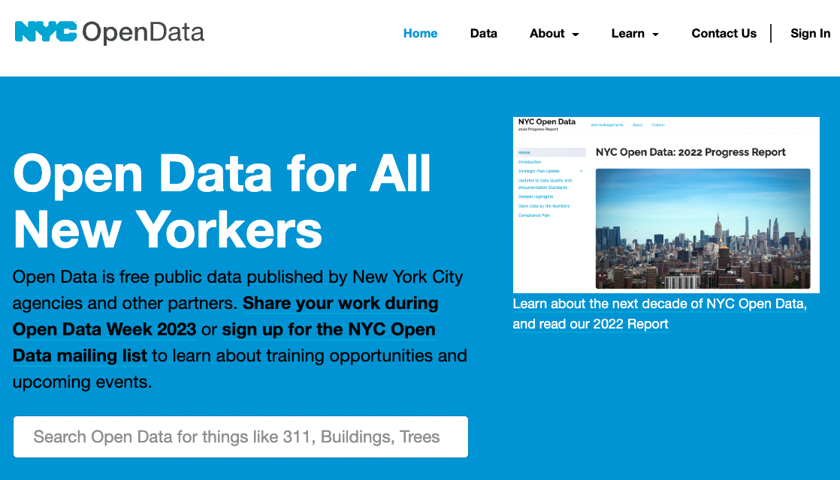
NYC Open Data
https://data.cityofnewyork.us

Slide 12
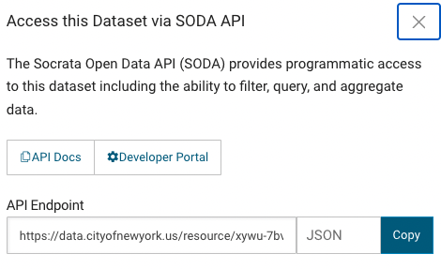
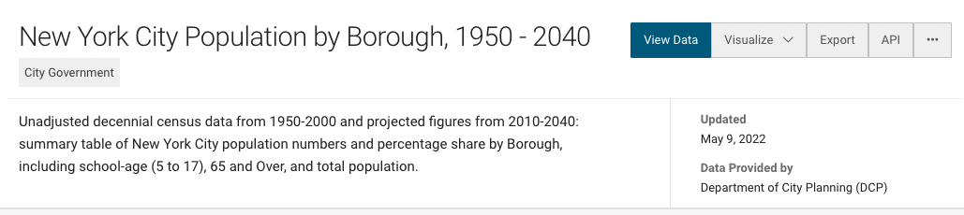
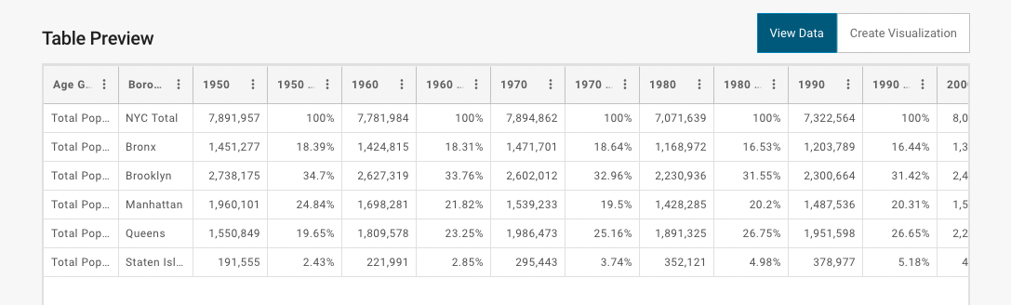
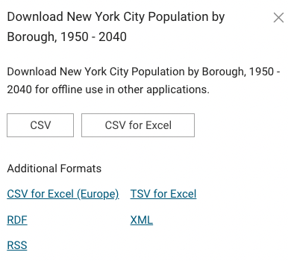
Export (Download) or API

Slide 13
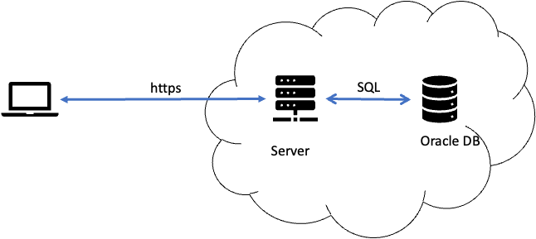
SODA Application Program Interface (API)
SODA for Python
SODA for Python is a Python API that implements Simple Oracle Document Access (SODA).
You can use it to query JSON documents.
SODA is a set of NoSQL-style APIs that let you create and store collections of documents in Oracle Database, retrieve them, and query them, without needing to know how the documents are stored in the database.

Slide 14
SodaPy and Socrata
https://dev.socrata.com/consumers/getting-started.html
To use the API you will need the endpoint (URL) and app token.
You can get an app token for NYC here: https://data.cityofnewyork.us/profile/edit/developer_settings

Slide 15
Connect to API
from sodapy import Socrata
import requests
clientNYgov = Socrata('data.ny.gov', '5aDY21HsXXuhyCmjUSPBkZWSN')

Slide 16
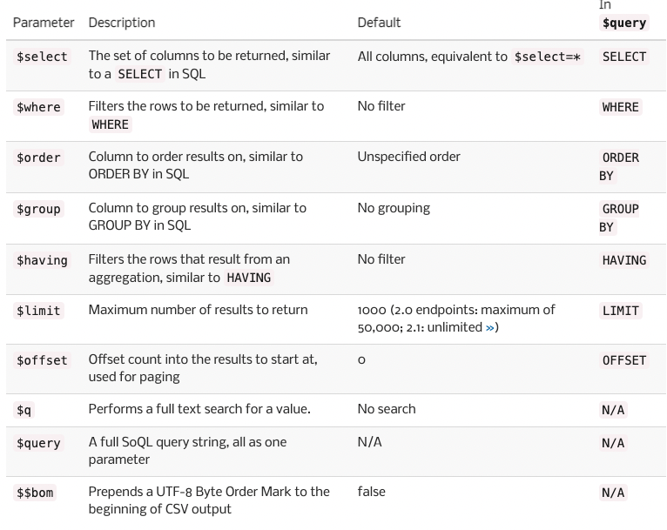
Socrata Query Langauge (SoQL)
data=requests.get('https://data.cityofnewyork.us/resource/erm2-nwe9.json?$limit=10').json()
df=pd.DataFrame.from_records(data)
data=requests.get('https://data.cityofnewyork.us/resource/erm2-nwe9.json?$select=created_date,complaint_type,city,status&$where=created_date>="2022-10-24"').json()
df=pd.DataFrame.from_records(data)

Slide 17
Maps and GeoLibraries

Slide 18
Maps with the plotly express library
import plotly.express as px
color_scale = [(0, 'orange'), (1,'red')]
fig = px.scatter_mapbox(df,
lat="latitude",
lon="longitude",
hover_data=["city", "complaint_type"],
color="status",
color_continuous_scale=color_scale,
zoom=9,
height=600,
width=600)
fig.update_layout(mapbox_style="open-street-map")
fig.show()

Slide 19
Calculating Distance with geopy
from geopy import distance
Rockefeller = (-73.9, 40.76)
Battery = (-74.01, 40.7)
print(distance.distance(Rockefeller, Battery).miles)

